Slide 1
Evaluation Metrics for Time Series

Slide 2
Evaluation Metrics for Time Series
Mean Forecast Error(MFE)
Mean Absolute Error(MAE)
Mean Absolute Percentage Error(MAPE)
Mean Square Error(MSE)
Root Mean Square Error(RMSE)

Slide 3
Mean Forecast Error(MFE)
Mean Forecast Error shows deviation of the forecast from the actual demand.
This is the mean of the sum of all the differences between the actual values and forecasted values.
Let’s consider 10 data points
-2, -4, 3, 8, -3, -8, 1, -1, 5, -5
Sum of errors = 0

Slide 4
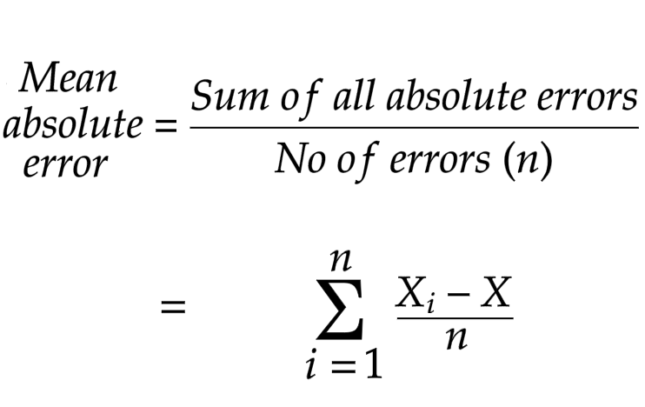
Mean Absolute Error(MAE)
Mean Absolute Error takes the absolute values of the differences between actual values and forecasted values.

Slide 5
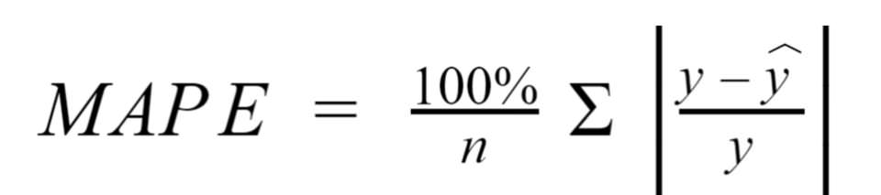
Mean Absolute Percentage Error(MAPE)
Mean Absolute Percentage Error calculates the percentage of mean absolute error to get a clear idea of how much the forecasted values deviates from the actual values.

Slide 6
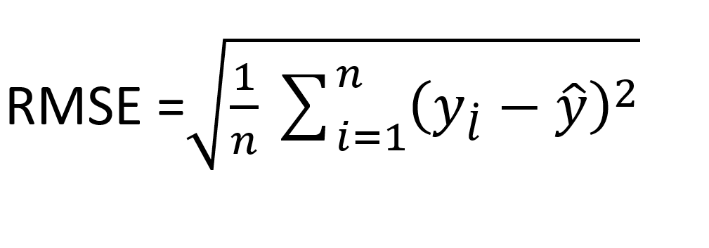
Root Mean Square Error(RMSE)
Root Mean Square Error is equal to the root of the Mean Square error in order to bring error value to the same dimension.

